Slide 1
NANTUCKET PUBLIC SCHOOLS
2018 MCAS Results
October 2, 2018

Slide 2
NEW FOR 2018
NIS & CPS:
No more CPI for ELA & Math (Science still CPI)
Compare 2018 Results to 2017 Baseline
Scoring scale: 440-560
Average scaled score
Incremental Targets set from 2017 Baseline average
High School vs. Non-High School Categories
Either ‘Met Target’ or ‘Partially Met Target’
Either ‘Not requiring assistance or intervention’ or ‘Requiring assistance’ (bottom 10 percentile)

Slide 3
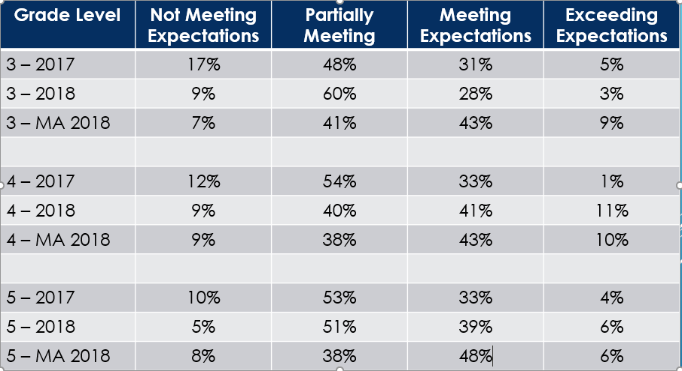
NIS Achievement Distribution - ELA

Slide 4
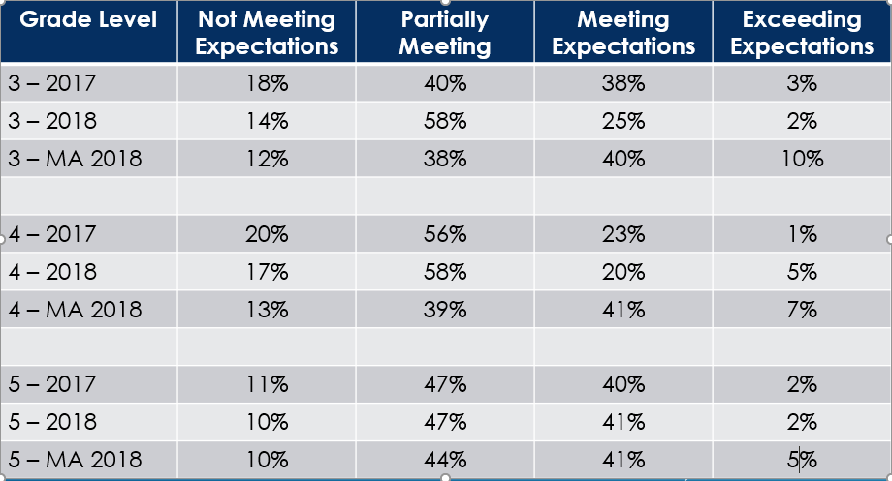
NIS Achievement Distribution - MATH

Slide 5
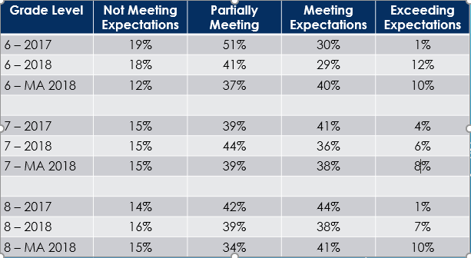
CPS Achievement Distribution - ELA

Slide 6
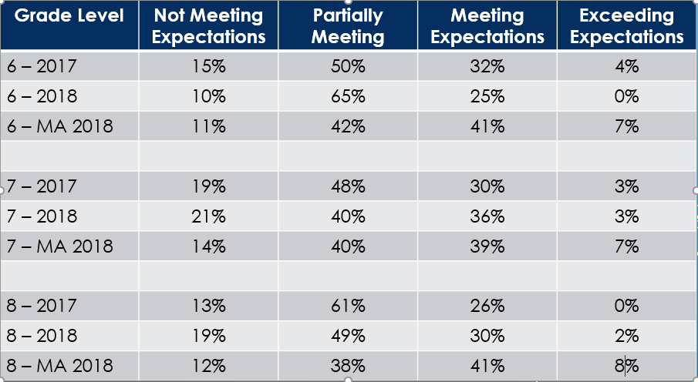
CPS Achievement Distribution - MATH

Slide 7
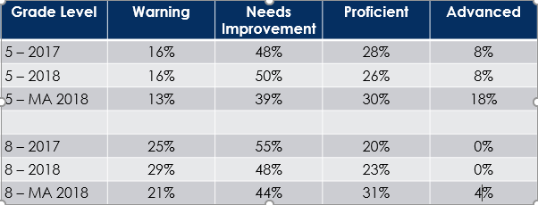
NIS & CPS Achievement Distribution - Science

Slide 8
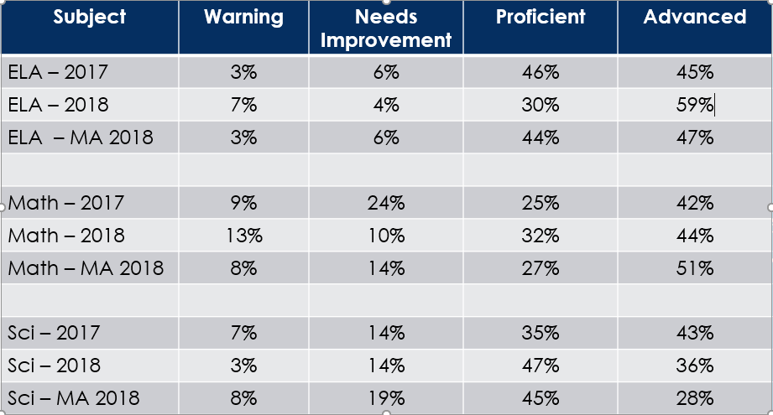
NHS Achievement Distribution

Slide 9
Grade-level 2017 to grade-level 2018
GROWTH | NOT YET
Gr3 ELA Not M decreased 17% to 9% | Gr3 ELA M&E decreased 36% to 31%
Gr3 Math Not M decreased 18% to 14% | Gr3 Math M&E decreased 41% to 27%
Gr4 ELA M&E increased 34% to 52%
Gr4 ELA Not M decreased 12% to 9%
Gr4 Math M&E increased 24% to 25%
Gr4 Math Not M decreased 20% to 17%
Gr5 ELA M&E increased 37% to 45%
Gr5 ELA Not M decreased 10% to 5% | Gr6 Math M&E decreased 36% to 25%
Gr5 Math M&E increased 42% to 43% | Gr7 ELA M&E decreased 45% to 42%
Gr5 Math Not M decreased 11% to 10% | Gr7 ELA Not M stayed same at 15%
Gr6 ELA M&E increased 31% to 41% | Gr7 Math Not M increased 19% to 21%
Gr6 ELA Not M decreased 19% to 18% | Gr8 ELA M&E stayed same at 45%
Gr6 Math Not M decreased 15% to 10% | Gr8 ELA Not M increased 14% to 16%
Gr7 Math M&E increased 33% to 39% | Gr8 Math Not M increased 13% to 19%
Gr8 Math M&E increased 26% to 32% | Gr10 ELA M&E decreased 91% to 89%

Slide 10
(+) Grade 10 Math Proficient & Advanced increased from 67% to 76%
(-) Grade 10 Math Failing increased from 9% to 13%
(+) Grade 9 Biology Proficient & Advanced increased from 78% to 83%
(+) Grade 9 Biology Failing decreased from 7% to 3%

Slide 11
Same students 2017 to same students 2018
GROWTH | NOT YET
3-4 ELA M&E increased 36% to 52% | 3-4 Math M&E decreased 41% to 25%
3-4 ELA Not M decreased 17% to 9%
3-4 Math Not M decreased 18% to 17%
4-5 ELA M&E increased 34% to 45%
4-5 ELA Not M decreased 12% to 5%
4-5 Math M&E increased 24% to 43%
4-5 Math Not M decreased 20% to 10%
5-6 ELA M&E increased 37% to 41% | 5-6 Math M&E decreased 42% to 25%
5-6 Math Not M decreased 11% to 10% | 5-6 ELA Not M increased 10% to 18%
6-7 ELA M&E increased 31% to 42% | 6-7 Math Not M increased 15% to 21%
6-7 ELA Not M decreased 19% to 15% | 7-8 ELA M&E stayed same at 45%
6-7 Math M&E increased 36% to 39% | 7-8 ELA Not M increased 15% to 16%
 | 7-8 Math decreased 33% to 32%
 | 7-8 Math Not M stayed the same at 19%

Slide 12
NIS
CPS
NHS
Nantucket Public Schools
2018 Accountability Results

Slide 13
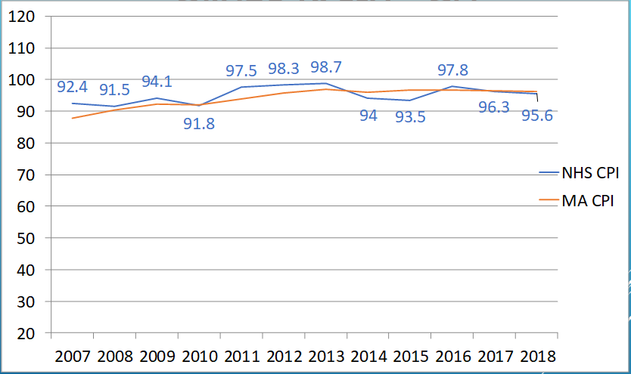
GRADE 10 ELA – CPI

Slide 14
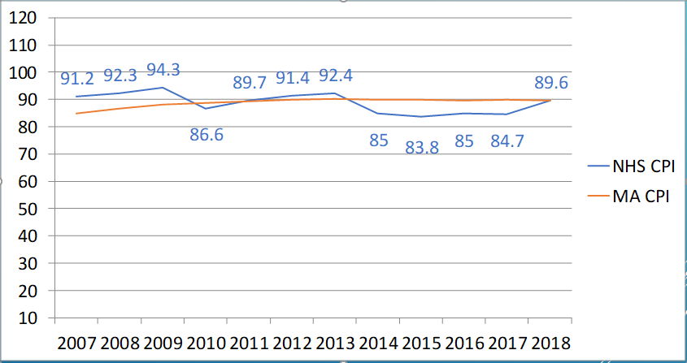
GRADE 10 MATH – CPI

Slide 15
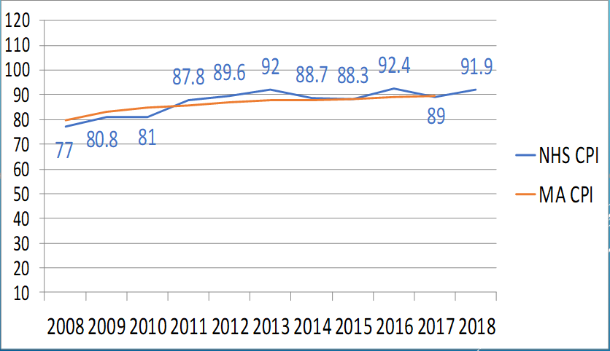
NHS SCIENCE – CPI

Slide 16
Summary
NIS Met 75% target with a 78%!
CPS: 64% NHS: 44%
2018 Percentiles: NIS: 36 CPS: 30 NHS: 42
2016 Percentiles: NES: 20 CPS: 34 NHS: 35 (2017)
New system sets targets with incremental growth year to year and provides specific results for all subgroups in the categories of: Achievement, Growth, EL Progress, High School Completion, and Absenteeism
We are moving kids in the right direction to be in the top 50% of state
Great results for NHS Math & Science

